Slide 1
Geo
A geometric solution language
Qi Wang, Yuechen Zhao
Zichen Chao, Ziyi Luo

Slide 2
Motivation
Geometry is useful in mathematics, physics, computer science and so many fields.
But built-in support for graphs are not provided in most programming languages.
Geo is here to help!
A simple while powerful language for graph creation and manipulation.
The best part about Geo - dynamic graphs.

Slide 3
Language Tutorial
A basic sample
No entry function
function gcd(a:int, b:int): int:
while(a != b):
if(a>b):
a = a - b;
else:
b = b - a;
end
end
return a;
end
control structures: if-else, while, for
data types: int, float, bool, char, string
keyword end defines the scope

Slide 4
Language Tutorial
Something special
Geometric types: line, dot, polygon, circle
model dot(x:float, y:float);
model line(dot1:dot,dot2:dot);
model polygons: polygons(num_of_apex:int,apex[]:dot);
model circle: circle(center:dot,radius:float);
Presets:
@panel panelname (essential) - defines a panel
@mode workingmode (optional) – console/figure
@co cosystem (optional) - coordinate system, cartesian/polar
@end (essential) - the boundary of a specific panel
Dynamics:
model runset: runset(times_of_run:int, g1:geometric_shape, run_para_g1:char, ...);
function setRunstep(val:float,pos:char):void;

Slide 5
Language Tutorial
Advanced stuff
//panel presets
@panel panel_demo
@mode figure
//geometric shape declaration and initialization
line1 = line(2.0,3.0);
circle1 = circle([3,4], 5);
//runset declaration and initialization
line1.setRunstep(-0.5,'a');
circle1.setRunstep(0.1,'b');
rs = runset(50, line1, 'a', circle1, 'b');
//run statement description
run rs:
set = line1.intersect(circle1);
if (!set.empty())
print_dot_list(set);
end
@end
mode that the program will be executed in
geometric types: dot, line, circle and polygons
geometric control type - runset
keyword run -dynamic analysis
print intersection points

Slide 6
Language Tutorial
Add the graph example of last slide here
???

Slide 7
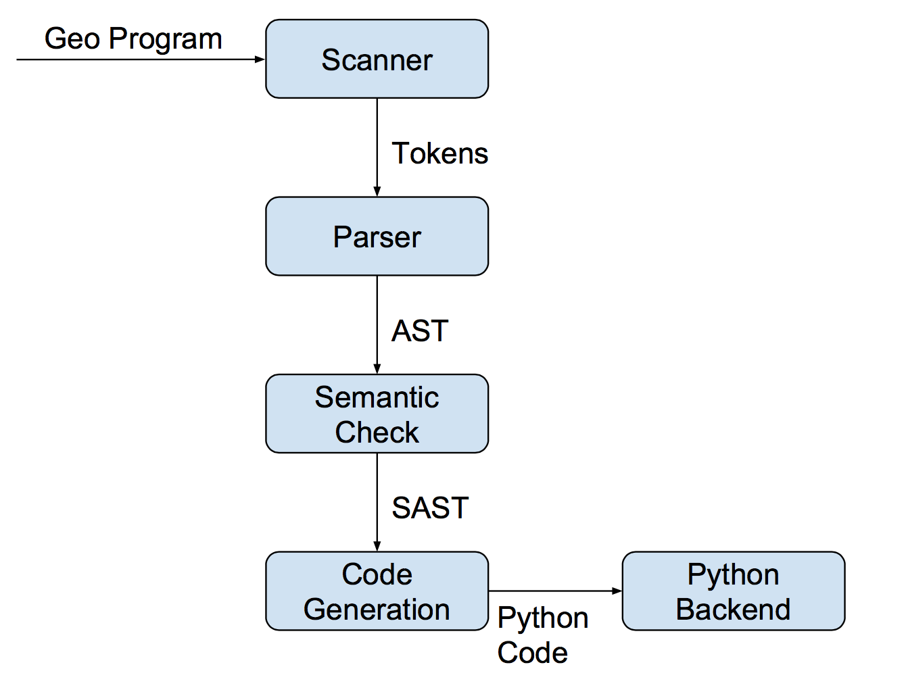
Architecture

Slide 8
Architecture
Source code statistics
File | Lines | Role
scanner.mll | 95 | Breaks input stream into tokens
parser.mly | 135 | Parses tokens into an AST
ast.ml | 50 | Defines acceptable AST structure
pyast.ml | 38 | Defines acceptable python AST structure
compile_sc_py.ml | 377 | Translates geo AST to python AST
compile_to_pycode.ml | 78 | Generates python code
geo_sc_py.ml | 13 | Top level

Slide 9
Semantic Check
Semantic Check
Use StringMap to implement translation environments
vars: keep information about variables
funcs: keep information about functions
func_opt: keep information about function parameters ?
Check for:
undeclared variables and functions
mismatched types
wrong types
function parameters not match
undefined operations
Geo syntax error
…..

Slide 10
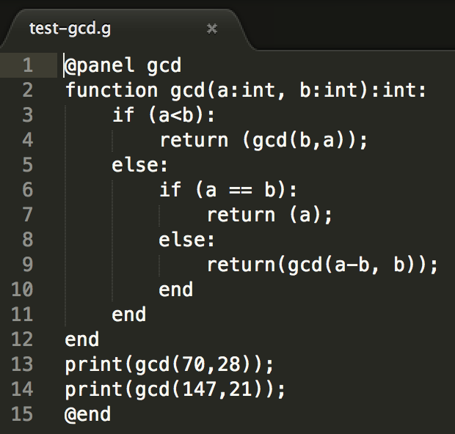
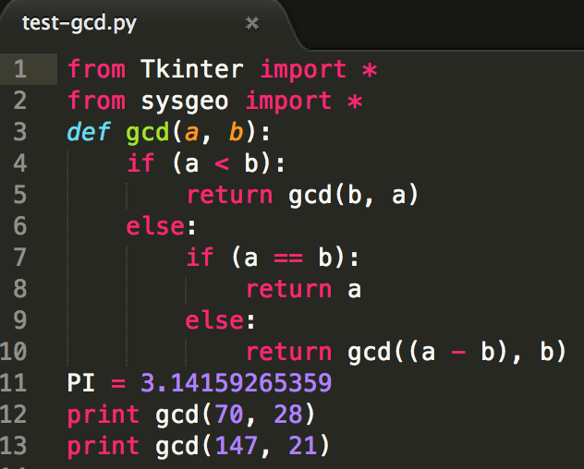
Code Generation
Algorithm Example (demo_fb.g)

Slide 11
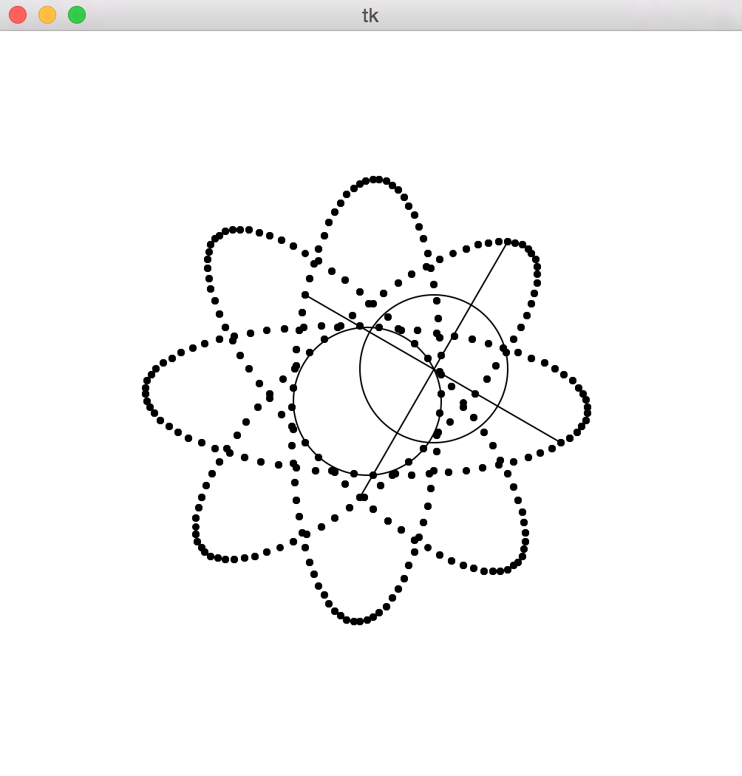
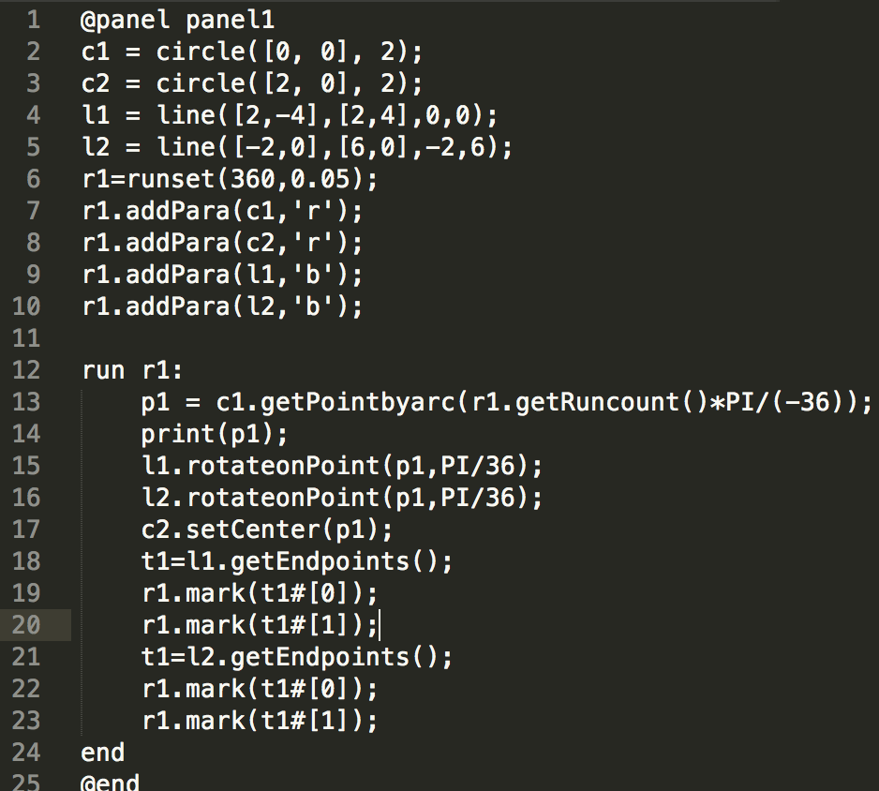
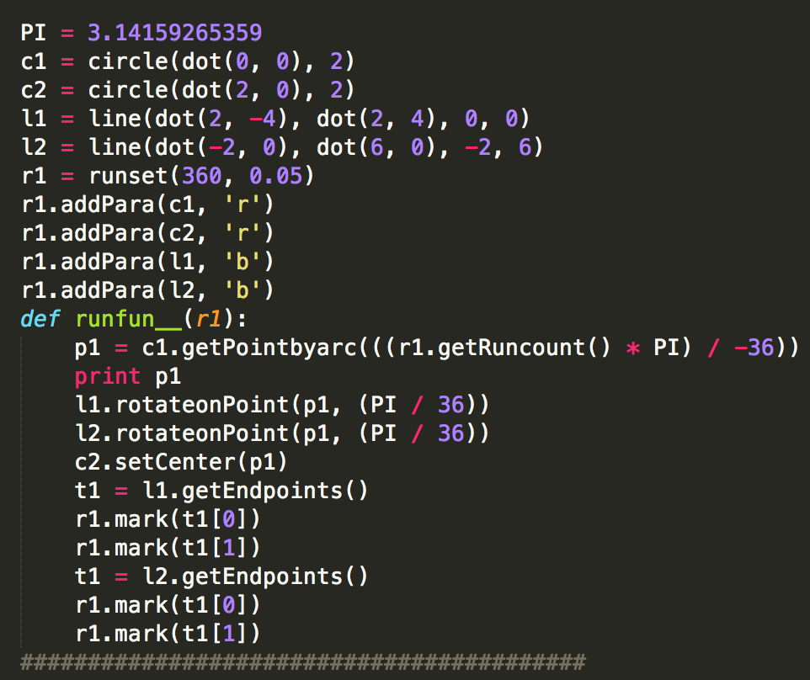
Code Generation
Graph Example

Slide 12
Testing
Test case statistics ?
File Name | #Files | Lines | Role
error-semantics*.g | 2 | 6 | Semantic error check
error-syntax*.g | 5 | 6 | Syntax error check
Test-assignments.g | 1 | 14 | Legal/illegal assignments check
Test-*(shape).g | 5 | 78 | Shape objects definition check
Test-comparison.g | 1 | 11 | Legal/illegal comparison check
test-operations.g | 1 | 20 | Arithmetic operations check
Test-for.g | 1 | 5 | For loop check
Test-function.g | 1 | 21 | Function declarition check
Test-if.g | 1 | 11 | If statement check
test-print.g | 1 | 10 | Print function check
Test-while.g | 1 | 7 | While loop check

Slide 13
Lessons Learned
Qi Wang:
“Start early on the project and make a plan ahead, if things are different from scheduled, discuss together and activate soon.”
Yuechen Zhao:
“Effective communications are the key to success, do not waste too much time on arguing plans, but discussion is important.”
Zichen Chao:
“Keep the whole picture in mind, modify the plan as the project progressed and learn Ocaml as early as possible!”
Ziyi Luo:
“Comprehensive test cases are important and test early, you can never imagine how many problems you may encounter when testing.”

